Slide 1
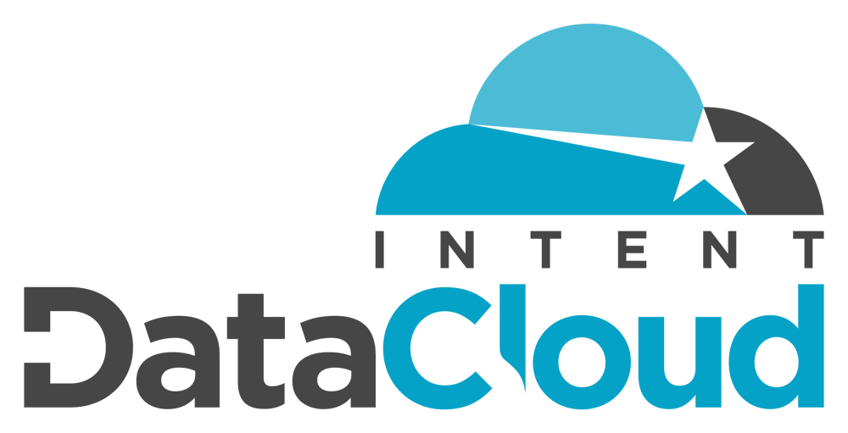
Vertical Insider DataCloud: B2B Intent Data Analytics
Topics for Discussion
About B2B Intent Data & Intent Analytics
Introducing VI Intent Data (Powered by Vertical Insider)
Vertical Insider's Intent Data Scoring: Part 1 - The “Intent Score”
Vertical Insider's Intent Data Scoring: Part 2 - The “Synthesized Intent Score”
Vertical Insider's Intent Data Scoring: Part 3 - The “Buying Temperature”
B2B Intent Data Records, Inputs and Analytics
History: Making the Case for Vertical Insider’s B2B Intent Data
Why is VI Intent Data (Powered by Vertical Insider) Different?

Slide 2
Vertical Insider B2B Intent Data Analytics
The Only B2B Intent Data and Intent Analytics that You’ll Ever Need.
Vertical Insider’s all new intent analytics platform offers intelligent B2B buyer intent data. Our intent data analytics are derived internally from Content Syndication, Demand Generation, Website Analytics, Email Marketing Metrics and Social Listening, among other channels.
The prospect of utilizing B2B Intent Data grows in popularity almost daily, and Vertical Insider’s new platform analyzes the content consumption of B2B companies and their employees in an effort to determine when there is active demand for specific types of products, business services and technology solutions. In other words, out intent analytics give us insight into which companies are likely in the buying cycle for specific types of products / solutions.
Vertical Insider intent data analytics are based on organizational content consumption, such as white paper downloads, asset and webinar registrations, website and landing page analytics, dedicated email marketing promotions, and social listening. In a nutshell, the intent data records houses within our platform can predict “your future customers” before they are even aware that they're actively looking to buy.

Slide 3
Vertical Insider B2B Intent Data Analytics
The Vertical Insider B2B Intent Data Analytics Solution.
Vertical Insider’s back-end data analytics use multiple sources to identify organizations that are actively researching specific products and solutions, with an implied intent to purchase said products and solutions in the near future (more to come on the timeline).
Based on white paper downloads, asset registrations, social interactions, and overall B2B content consumption, Vertical Insider’s intent data generates intelligent intent analytics that can be leveraged by customers to easily:
Build an export “Target Accounts Lists” (ABM Lists) made up of companies that are already interested in their products and solutions.
Overlay current targeting criteria – such as industry selects, company sizes targeted, and ideal annual revenue ranges – on top of companies that are associated with the appropriate intent topics for their lines of products and services.
Identify companies that range anywhere on the buying spectrum – from "actively researching" specific services and solutions, to those who have allocated budgets already in place, to the bottom of the funnel companies, that are ready to pull the trigger and decide on a vendor…
Depending on the current intent data and 3-tiered intent scoring, the impending purchase can be predicted to occur within the next 12 months, 6 months, 3 months, or even 30 days.
Speaking of scoring, every one of our 900,000+ B2B intent data records are scored in three different way to allow users to gauge and prioritize the accounts that are showing more intent than others:

Slide 4
Vertical Insider B2B Intent Data
VI Intent Data Scoring Mechanisms I: “The Intent Score”
Intent Score: An indication of the level of interest an organization has in any given intent topic(s), based on content consumption types, frequencies, and cross-organizational volume.
Vertical Insider's Intent Data’s standard “Intent Score” can be used to gauge the overall potential for conversions on a single intent topic, and, to allow for the prioritization of accounts.
Intent Scores are generated and provided to our customers in a numeric range between 5 and 9 (and anything in between, of course).
An Intent Score of 5 is the lowest mark that a company record can receive, showing buyer intent, but at a somewhat minimal level based on our overall scoring criteria.
An Intent Score of 9 is the highest mark that a company can receive, and generally speaking, is a valid predictor of those organizations having the most apparent need for a specific product, service or solution.
An intent score of 9 also conveys the highest potential for an organization to make purchasing decisions in the short run for their intent topic(s) of interest.
In addition to our baseline "Intent Score" metric, the Vertical Insider's Intent Data platform adds two additional layers of insight for each company showing buyer intent...

Slide 5
Vertical Insider B2B Intent Data
VI Intent Data Scoring Mechanisms II: “Synthesized Intent Score”
Synthesized Intent Score: A combined or converged type of intent score, calculated by the amount and frequency of related content being consumed by an organization.
For example, if a company is researching “Artificial intelligence (AI)” solutions – but also consuming content on other, AI related topics, such as “Machine Learning” and "Robotic Automation" – this could positively impact that company’s “Synthesized Intent Score.”
These types of combined or converged intent scores, just like regular Intent Scores, are also assigned a numeric value of either a 5, 6, 7, 8 or 9.
Consuming content from related topics can help to increase a record’s (company) Synthesized Intent Score – to where it becomes even more important and valuable to our customers than our standard Intent Score.
In looking at the "Artificial Intelligence" example from above... While the Artificial Intelligence, Machine Learning, and Robotic Automation “Intent Topic" scores may only be rated at a 6 or 7 (out of 9) individually, their Synthesized Intent Score (i.e. combines score) for these three (3) related topics might equate to an 8 or 9 depending on the level of content consumption and interaction.
The Synthesized Intent Score is also dependent on the types of content consumed, the frequencies, the channels utilized, and the company’s cross-organizational consumption volume.

Slide 6
Vertical Insider B2B Intent Data
VI Intent Data Scoring Mechanisms III: “Buying Temperature”
Buying Temperature: Is scored on a four (4) level, tiered scale – from “Level 1” (the highest level of purchase intent) to “Level 4” (which conversely, demonstrates the lowest level of intent).
Statistically significant “Buying Temperature” scores are available when companies and their associated employees actively express that they have either (1) a current budget in place, and/or (2) a favorable timeframe in place for making a purchasing decision related to the solution represented by the specific intent topic(s) that they are researching.
Companies and their employees influence their organizational Buying Temperature levels based on their responses to BANT, SQL, and SRL custom questions – which are aimed to extract more information about how quickly a company is looking to make a purchase decision and/or whether they already have a budget authorized / in place for any given Intent Topic(s).
Companies with no budget or foreseeable purchase timeframe (i.e. greater than 12 months into the future) – or – who have simply provided “no data” on their buying timeframe and/or approved budget are automatically scored at "Level 4" – which is of course the lowest Buying Temperature grade.
Companies that do have budgets planned and in place – or that have a buying timeframe in the ranges of < 30 days, 1-3 months, 3-6 months, or 6-12 months are assigned Buying Temperature scores that correspond with their standard Intent Scores, and the increased probability of making a purchase decision based on their current approved and/or planned budgets and timelines.
Level 1 is the highest Buying Temperature score. To give an example, a Level 1 grade might be representative of a company with an Intent Score of 8 or 9, but who has also indicated that they are ready to make a purchase within the next 30 days and/or have a budget approved and ready to go for the specific intent topics (products, solutions) that they have been researching.

Slide 7
Vertical Insider B2B Intent Data
VI Intent Data: The inputs, the sources, the viability and the analytics.
To reiterate, our intuitive intent data analytics measure the consumption of B2B content across multiple channels... Organizational content consumption via content syndication, white paper and webinar registrations, website and landing page analytics, and social listening are just some of the channels that we utilize.
The resulting product is a targeted compilation of highly viable buyer intent data records, which are used to predict and identify companies that are currently in the market for various B2B products, business services and technology solutions.
Vertical Insider and its associated web properties generate thousands of unique (highly targeted) B2B leads through internal content syndication and demand generation on a monthly basis.
As such, Vertical Insider's Intent Data’s analytics and platform are updated regularly. The intent data records that we provide to our customers are never “stale” or "outdated" lists, and we are always evolving to make things even more efficient from data quality standpoint.
The main takeaway is that our intent data is dynamic and always changing. To put it into consumer thinking… When somebody is in the market to buy a new car, how long do they remain in that market? Maybe a week, maybe a month, maybe a year? It’s all dependent on whether or not they even buy a new car… Then when they buy the new car… And then consequently, when they stop researching new cars.

Slide 8
Vertical Insider B2B Intent Data
How history helps build the case for intent data analytics.
Intent Data has been going strong for a couple of years, now, and we have already heard some real success stories via beta testers, case studies, testimonials, lead scoring metrics, conversion rates, and overall ROI calculations.
Based on recent third-party intent analytics case studies and internal organizational KPI's, here are a few of the notable success stories from some of the more well-known B2B brands in the industry:
Fortinet was able to significantly increase their efficiencies in terms of account prioritization with the use of intent data, which in turn, helped them drive their sales pipeline and increase revenue growth.
Salesforce experienced a return-on-investment of 271% for digital display and paid social ads thanks to intent data targeting. The use of intent data also cut Salesforce’s typical sales cycle time down by 33%.
Veristor experienced a two-fold increase in email open rates, an 18% increase in event attendance with intent data.
Oceanos increased their email marketing engagements by more than 25% with targeted intent data.
Marketo integrated intent data directly into their marketing automation platform, which greatly assisted sales and marketing by helping them identify the right accounts to engage with.
DataStax utilized intent data to prioritize accounts for social media and account-based marketing programs. The results yielded a 40% increase in paid social engagement, and a 60% increase in Terminus display advertising.
Turbonomic was able to increase their email conversion rates by 36% with the implementation of intent data.
OneLogin doubled their marketing campaign engagement and shortened their sales cycles via the use of intent data.
MarketMatrix used intent to I.D. current customers, target accounts, and repeat incidences of demonstrated intent.

Slide 9
Vertical Insider B2B Intent Data
What makes VI intent data analytics different… What makes them better?
The Vertical Insider's Intent Data platform and our backend analytics allow for full geographic targeting (company profiles by country) and install base intelligence targeting in certain, viable situations.
Our solution enables easier identification of companies that already have budget and/or have a planned purchase timeframe in mind for one or more products, services or solutions (intent topics).
We use a hybrid approach, collecting buyer intent data via content syndication (internal and third party), internal lead generation campaigns, web and landing page analytics, email marketing, page tracking intelligence, social listening strategies, and B2B market research surveys.
Implied Intent and Intent Scoring mechanisms are based on the frequency that an account is matched with specific and/or related intent data topics. Vertical Insider's Intent Data aggregates scoring across several criteria:
Consumption frequencies via individual campaigns.
Consumption frequencies across multiple and similar content types.
The variance in data sources utilized to measure and predict buyer intent.
The aggregate sources of information accessed with associated points of data origination.
The total number of different/varying channels used to record content consumption and intent probability.

Slide 10
Vertical Insider B2B Intent Data
Still not sold on intent data? What other companies are saying…
See How Intent Data Can Improve Your B2B Marketing
https://intentdatacloud.com/intent-data-b2b-marketing
Why Intent Data is the Future of B2B Marketing
https://intentdatacloud.com/intent-data-future-b2b-marketing
How Using Buyer Intent Data Can Leverage Your Marketing Strategy
https://intentdatacloud.com/buyer-intent-data-marketing-strategy
The Hidden Power of Intent Data: Harnessing What the Human Eye Can’t See
https://intentdatacloud.com/hidden-power-intent-data-analytics
Leveraging Intent Data to Drive Conversions
https://intentdatacloud.com/intent-data-to-increase-conversions
Intent Data Allows You to Identify Actionable Metrics, Avoid Vanity Metrics
https://intentdatacloud.com/intent-data-analytics-actionable-insights

Slide 11
Open For Questions

